Slide 1

Improving workplace Hireability and Employee Mental Health Through NLP
Capstone Project
by Brandon

Slide 2
47,000,000 US workers resigned in 2021

Slide 3
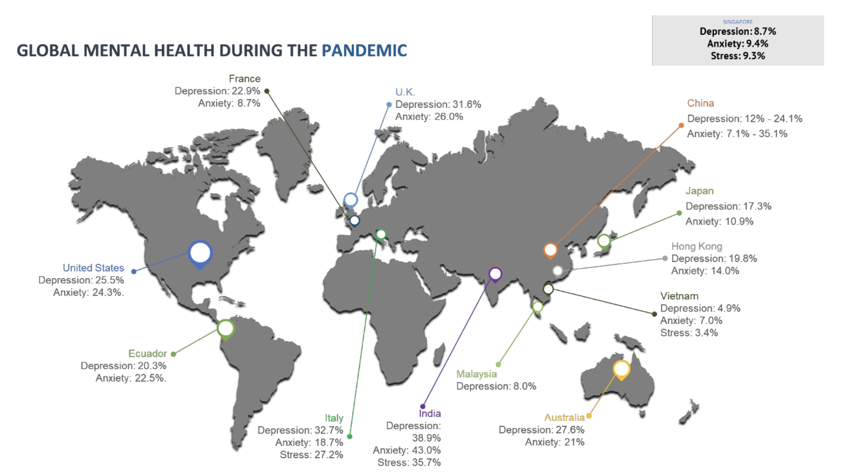

Slide 4
Problem Statement
Employee turnover rate has been high worldwide
Why are the employee's of certain company leaving?
Rising mental health issue
What is the underlying issue that employees face that are not explicit to the company's management?
Are the companies responsible for the failing mental health by employees?

Slide 5

Data extraction

Slide 6
Data extraction
Extracted from Glassdoor
Glassdoor uses Javascript Events
Selenium library for simulating human interaction with the website for scraping
Scraper credit to Matthew Chatham
https://github.com/MatthewChatham/glassdoor-review-scraper

Slide 7


COmpanies selected for experiment
Tencent – China leading internet company
Google – US leading internet company

Slide 8
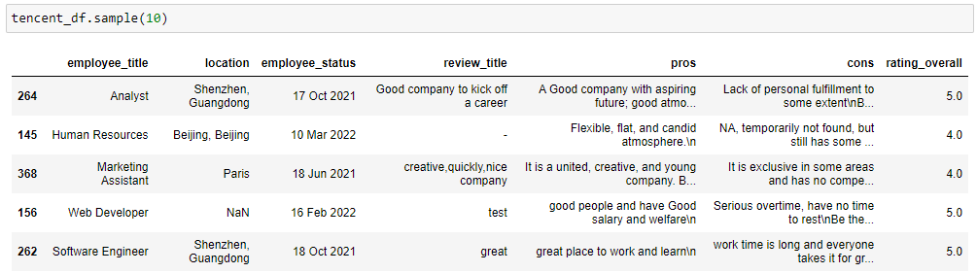
Sample extracted

Slide 9

Exploratory data analysis
Part 2

Slide 10
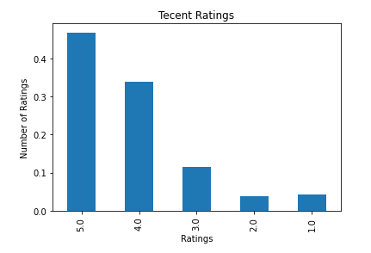
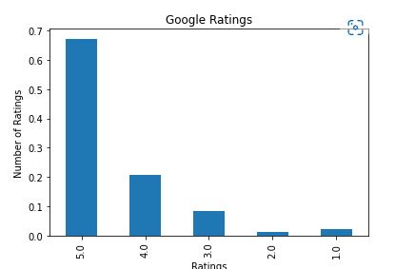
Ratings
Tencent – 67.2% (5 Stars) & 20.8% (4 Stars)
Google – 46.8.2% (5 Stars) & 33.8% (4 Stars)
About 7 % higher (Google)

Slide 11
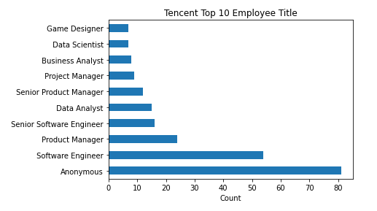
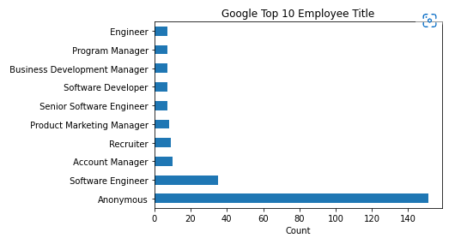
Ratings
Tencent – 67.2% (5 Stars) & 20.8% (4 Stars)
Google – 46.8.2% (5 Stars) & 33.8% (4 Stars)
About 7 % higher (Google)

Slide 12
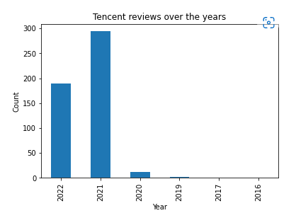
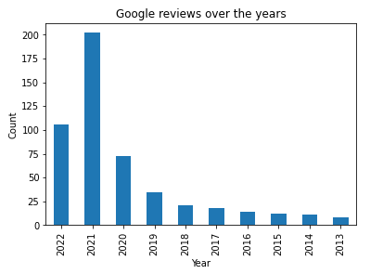
Date of reviews
Tencent did not have much presence until 2021
Number of review shot up in 2021 for both companies

Slide 13
Data preprocessing
Remove Punctuation and other symbols
Tokenising
Stopwords Removal
Lemmatising

Slide 14
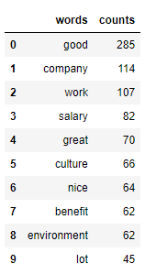
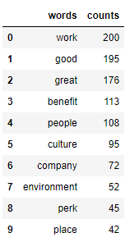
Pros

Slide 15
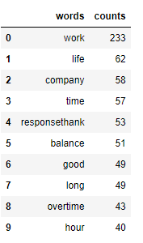
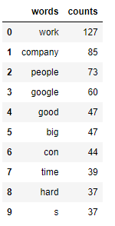
Cons

Slide 16
NLP model

Slide 17
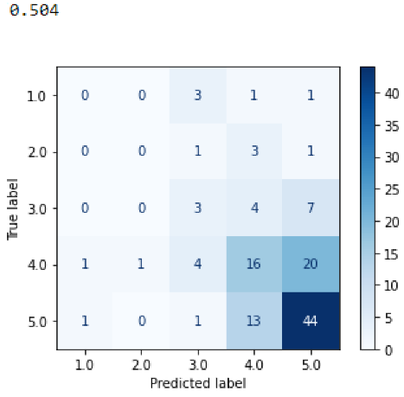
Accuracy and confusion Matrix
The best accuracy that I manage to achieve is 50.4%
This is achieved with
This is because the ratings given by the employees are subjective to individual
Thus with the naïve bayes model with feature engineered from count vectorizer

Slide 18
conclusion
Areas that the company is good and bad at
Companies can know which area to look into to improve their reputation
Improve the manpower issue in Singapore
Spot early signs of negativity within the company

Slide 19

Problems Discovered

Slide 20
Problems
There were very limited data on Singapore companies
Could it be that employees in Singapore are mostly afraid to voice out due to fear of being penalized?
Although the identity is anonymous, assumptions can be made on who posted the reviews
Discouraged employees from voicing out

Slide 21
Action
Create a platform for Singaporeans to openly voice out on their professional life
Identity to stay anonymous
The information will be kept completely confidential

Slide 22
Other Enhancement
Review and create own set of stopwords to improve the performance
Hone the visuals for better presentation
Topic Modeling (using Gensim)
Aspect Mining

Slide 23

scalability

Slide 24
Growth potential
Expand into consultant services for companies
Additional Revenue Stream

Slide 25

Thank you
This Photo by Unknown author is licensed under CC BY-SA.

